Slide 1
Predictive Maintenance of Industrial Machinery Using machine learning
CAPSTONE PROJECT
Presented By:
1. Mohammad Abith - K N S Institute Of Technology

Slide 2
OUTLINE
Problem Statement
Proposed System/Solution
System Development Approach (Technology Used)
Algorithm & Deployment
Result (Output Image)
Conclusion
Future Scope
References

Slide 3
Problem Statement
Industrial machines are often the backbone of manufacturing operations. Unexpected breakdowns cause costly disruptions. While machines collect vast sensor data, it’s difficult to spot early failure signals. This problem focuses on analyzing real-time sensor data to predict failures, enabling proactive maintenance. Early detection helps organizations minimize unplanned downtime, control expenses, and maintain reliable equipment performance.

Slide 4
Proposed Solution
Develop a machine learning predictive maintenance model that anticipates the failures before it occurs. It involves analysing sensor data from machinery to identify the patterns that precede a failure.
Data Collection:
Gather historical and real-time sensor data from all relevant industrial machines. Dataset Link - https://www.kaggle.com/datasets/shivamb/machine-predictive-maintenance-classification?resource=download
Perform exploratory data analysis (EDA) to understand the data, handle outliers, identify missing values, and observe trends related to different failure types.
Data Preprocessing:
Clean the dataset by imputing missing values and removing duplicates. Normalize or standardize sensor readings to bring features onto the same scale.
Feature engineering to extract relevant features from the data. Label encode categorical variables and split the data into train and test sets.
Machine Learning Algorithm:
Implement a machine learning algorithm, (Decision Tree, Random Forest, or SVM) to predict based on historical patterns.
Consider incorporating other factors like
Deployment:
Deploy the trained predictive maintenance model on IBM Cloud Lite services. Use IBM Watson Machine Learning to host the model, creating an API endpoint that receives real-time sensor data and returns failure predictions.
Integrate IBM Cloud Object Storage for storing sensor data and logs. Utilize IBM Cloud Monitoring and IBM Cloud Dashboard for real-time visualization and monitoring of machine health and prediction alerts.
Evaluation:
Evaluate the model using metrics like accuracy, precision, recall, F1-score, and confusion matrix, focusing on early and correct failure detection for each type.
Analyze misclassified cases to further refine the model or data features.

Slide 5
System Approach
The "System Approach" section outlines the overall strategy and methodology for developing and implementing the Predictive Maintenance of Industrial Machinery. Here's a suggested structure for this section:
System requirements :
IBM Cloud(Mandatory).
IBM Watsonx.ai Studio (service) for model development and deployment.
IBM Cloud object Storage for dataset Handling.

Slide 6
Algorithm & Deployment
Algorithm Selection:
Snap Random Forest Classifier (or SVM based on the input given and the performance).
Data Input:
Air Temperature [K], Process Temperature [K], Rotational Speed [rpm], Torque [nm], Tool wear[min], Target.
Training Process:
Multiclass Classification using the given labelled dataset (fault types).
Prediction Process:
Machine Learning Model deployed on IBM Watsonx.ai Studio with API key endpoint for real-time predictions.

Slide 7
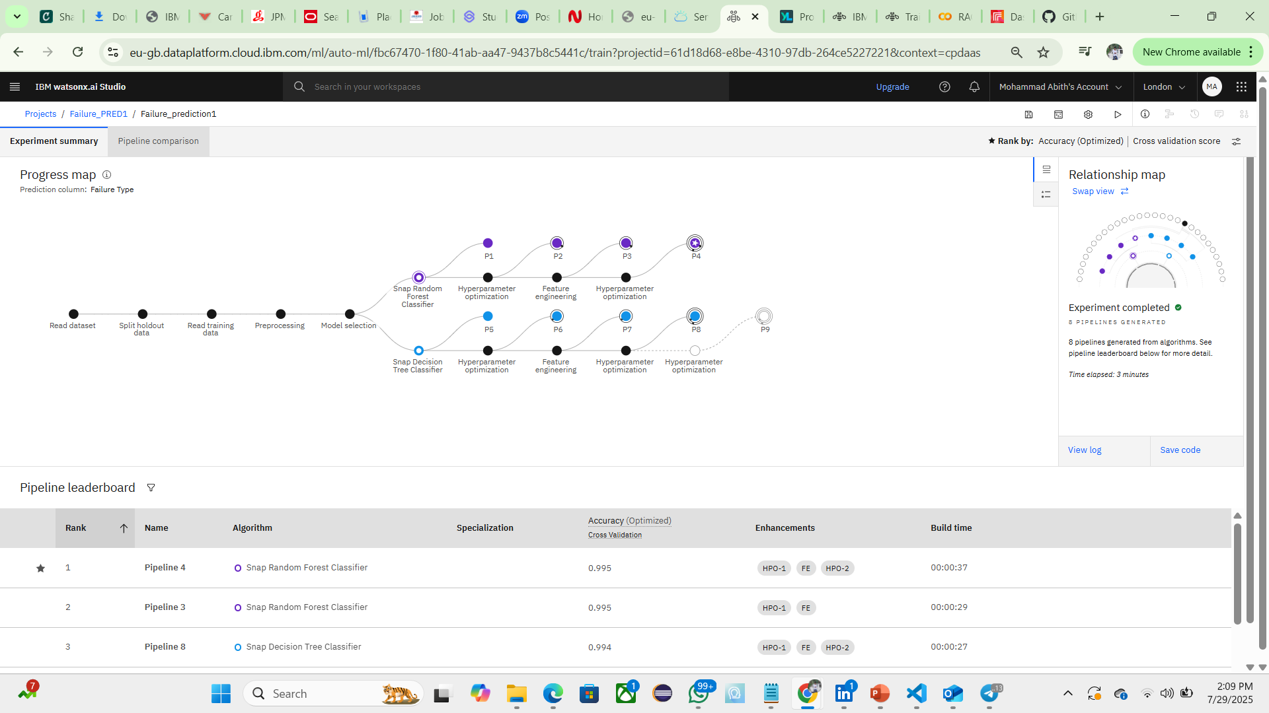
Result

Slide 8
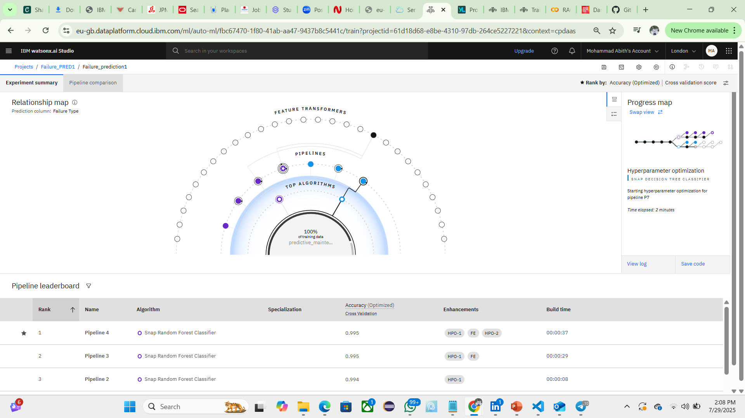

Slide 9
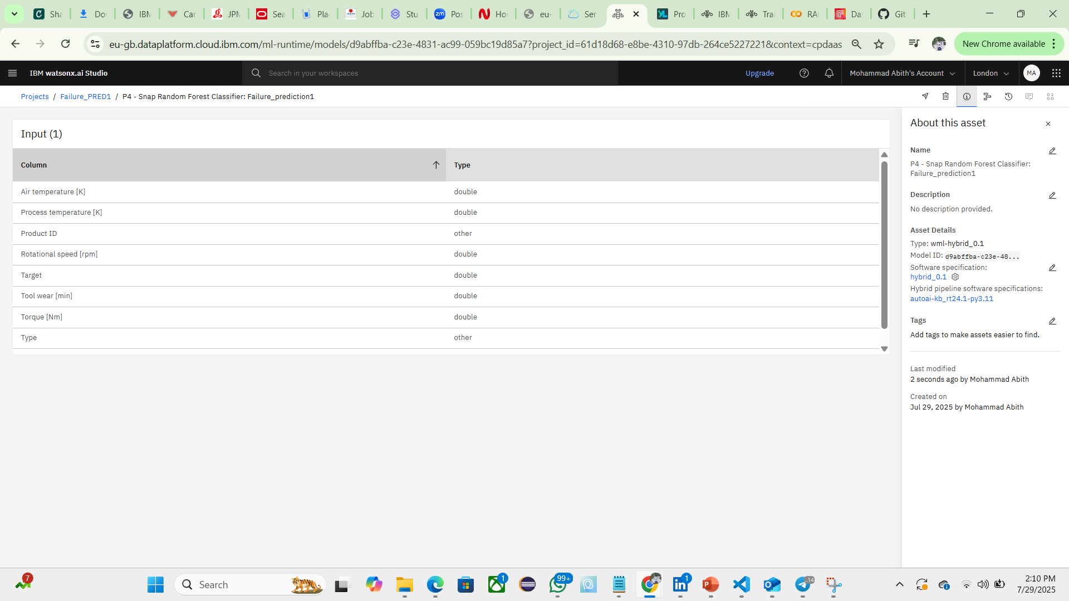

Slide 10
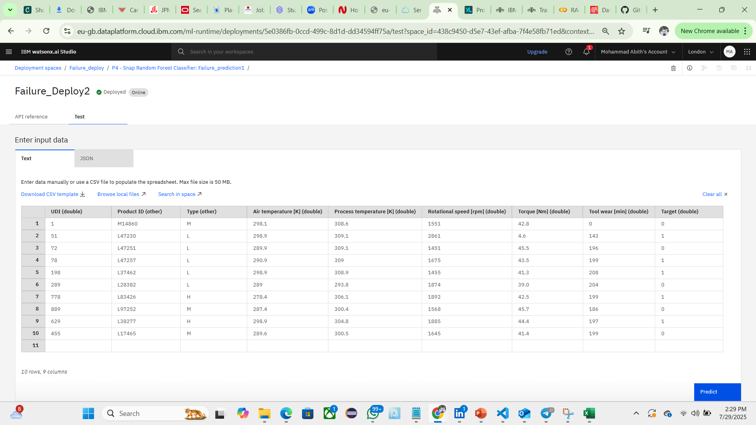

Slide 11
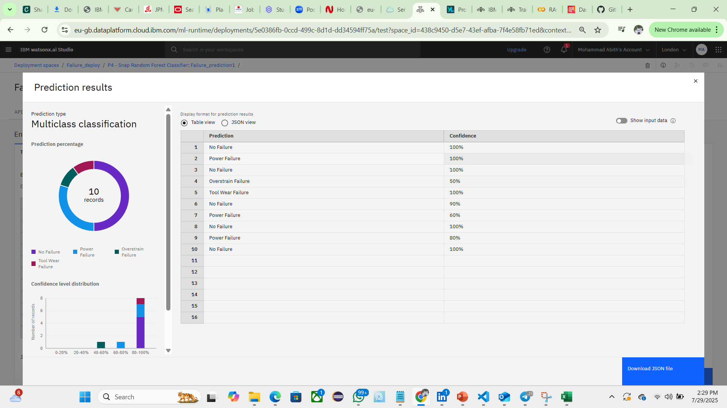

Slide 12
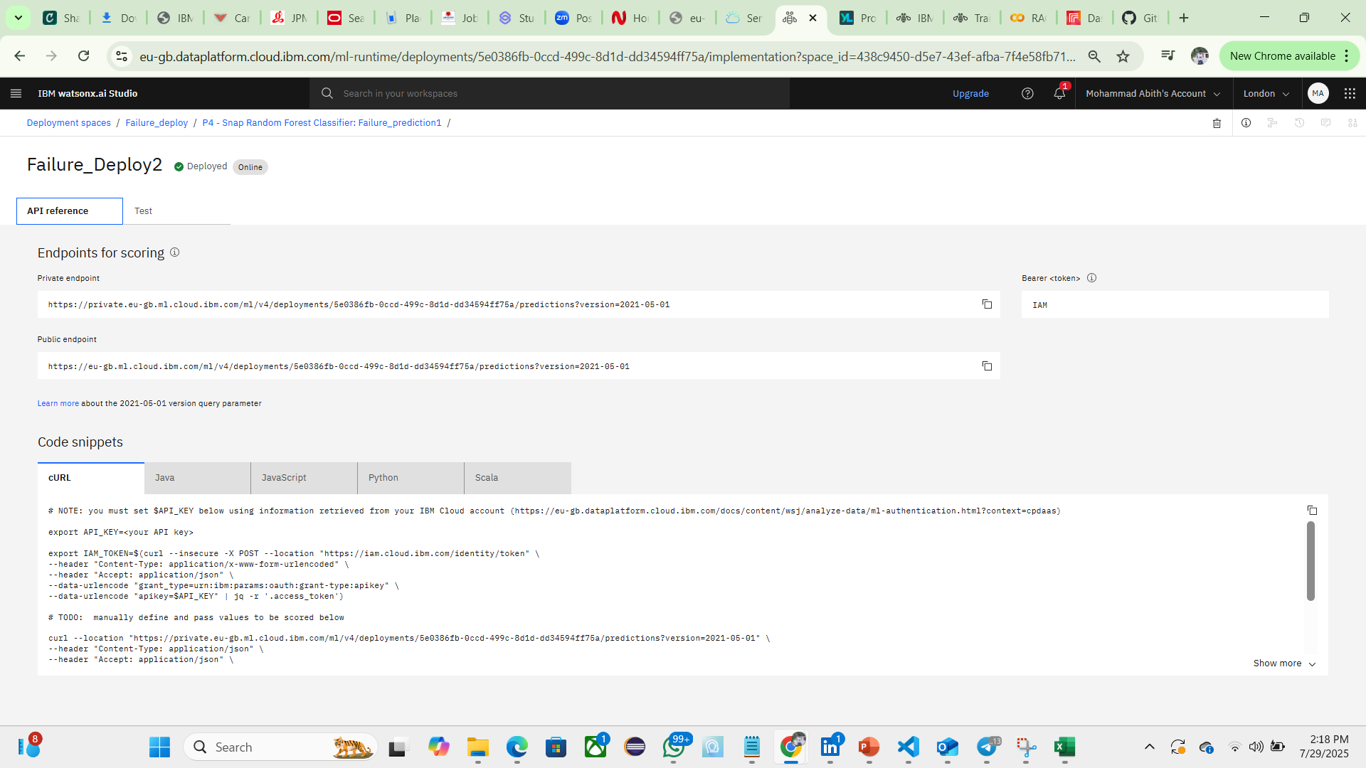

Slide 13
Conclusion
This project involved developing and deploying a predictive maintenance solution for industrial machinery using IBM Cloud’s watsonx.ai studio. By analyzing sensor data, the model accurately forecasts equipment failures before they occur. The deployment on IBM Cloud enables real-time monitoring, automated alerts, and seamless integration into existing maintenance operations, resulting in reduced downtime and improved operational efficiency. The project demonstrates the effectiveness of cloud-based AI in delivering practical, scalable, and reliable solutions for industrial challenges.

Slide 14
Future scope
Regularly retrain the model with new data to maintain performance.
Incorporate real-time data streaming and edge computing for faster alerts.
Integrate additional data sources, such as maintenance logs, to improve predictions.
Explore more advanced algorithms in watsonx.ai studio for higher accuracy.
Scale the solution to monitor more machines across multiple locations using IBM Cloud.

Slide 15
References
Dataset for the training and testing – (https://www.kaggle.com/datasets/shivamb/machine predictive-maintenance-classification)
IBM watsonx.ai Studio (Service) – For model development and deployment.(https://eu-gb.dataplatform.cloud.ibm.com/home2?context=cpdaas)
IBM Cloud Object Storage for dataset storage – (https://cloud.ibm.com/objectstorage/crn%3Av1%3Abluemix%3Apublic%3Acloud-object-storage%3Aglobal%3Aa%2F1bce4637ca4d42c69327360f8df7b855%3A322a16f7-81d3-46ff-accf-b66e7514a17d%3A%3A)
Public Endpoint (after deployment) – (https://eu-gb.ml.cloud.ibm.com/ml/v4/deployments/5e0386fb-0ccd-499c-8d1d-dd34594ff75a/predictions?version=2021-05-01)
IBM SkillsBuild Platform – Helped to get the knowledge about cloud and Artificial Intelligence.
GitHub Repository link – (https://github.com/mdabith123?tab=repositories)

Slide 16
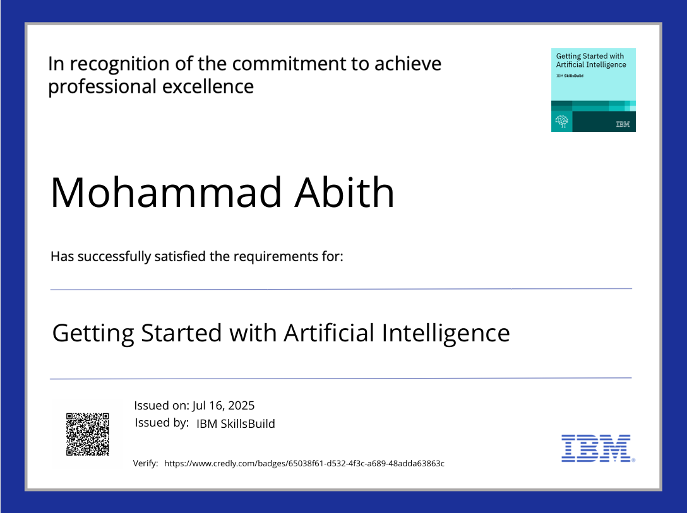
IBM Certifications

Slide 17
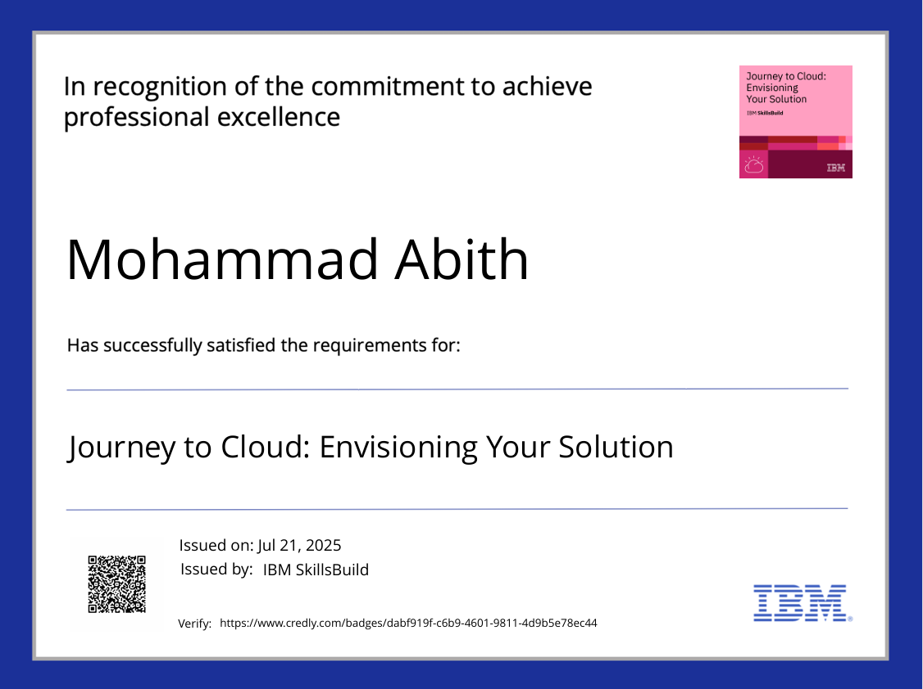
IBM Certifications

Slide 18
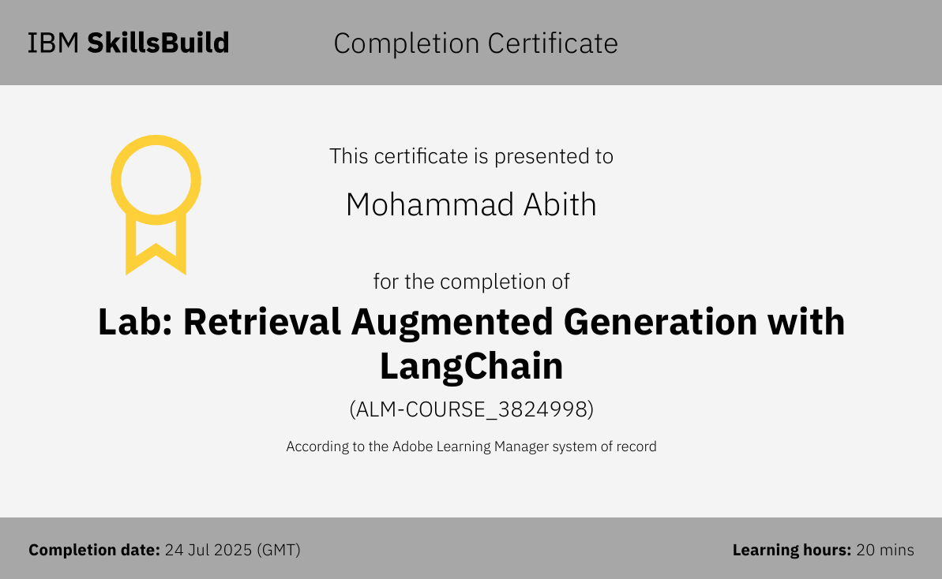
IBM Certifications

Slide 19
THANK YOU

